Slide 1

16TH ANNUAL LUNCHEON IN PINK
Sponsorship Opportunities
501(c)(3)

Slide 2
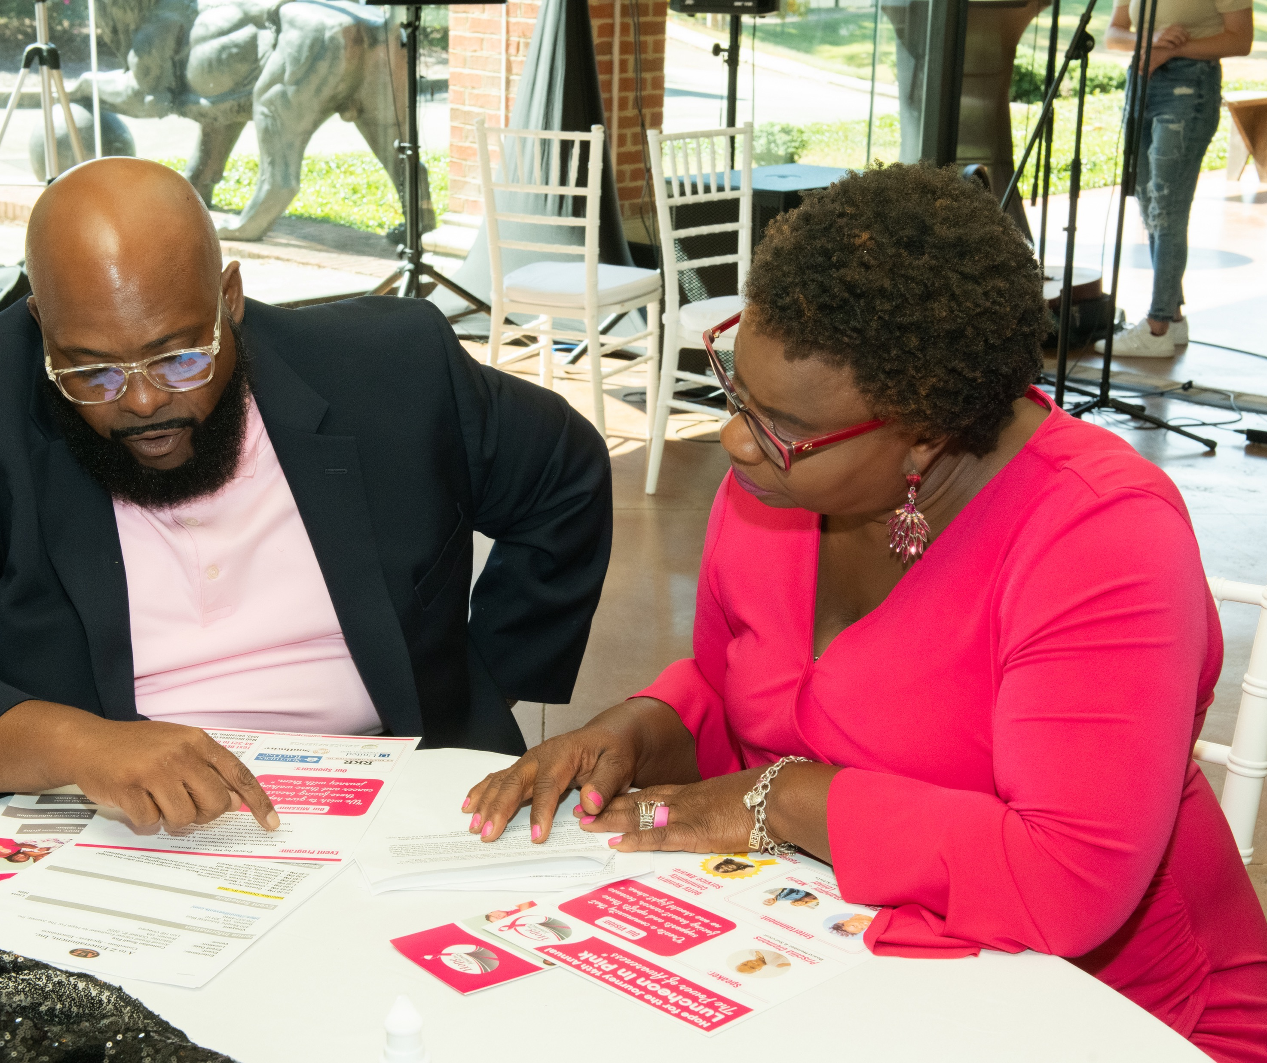
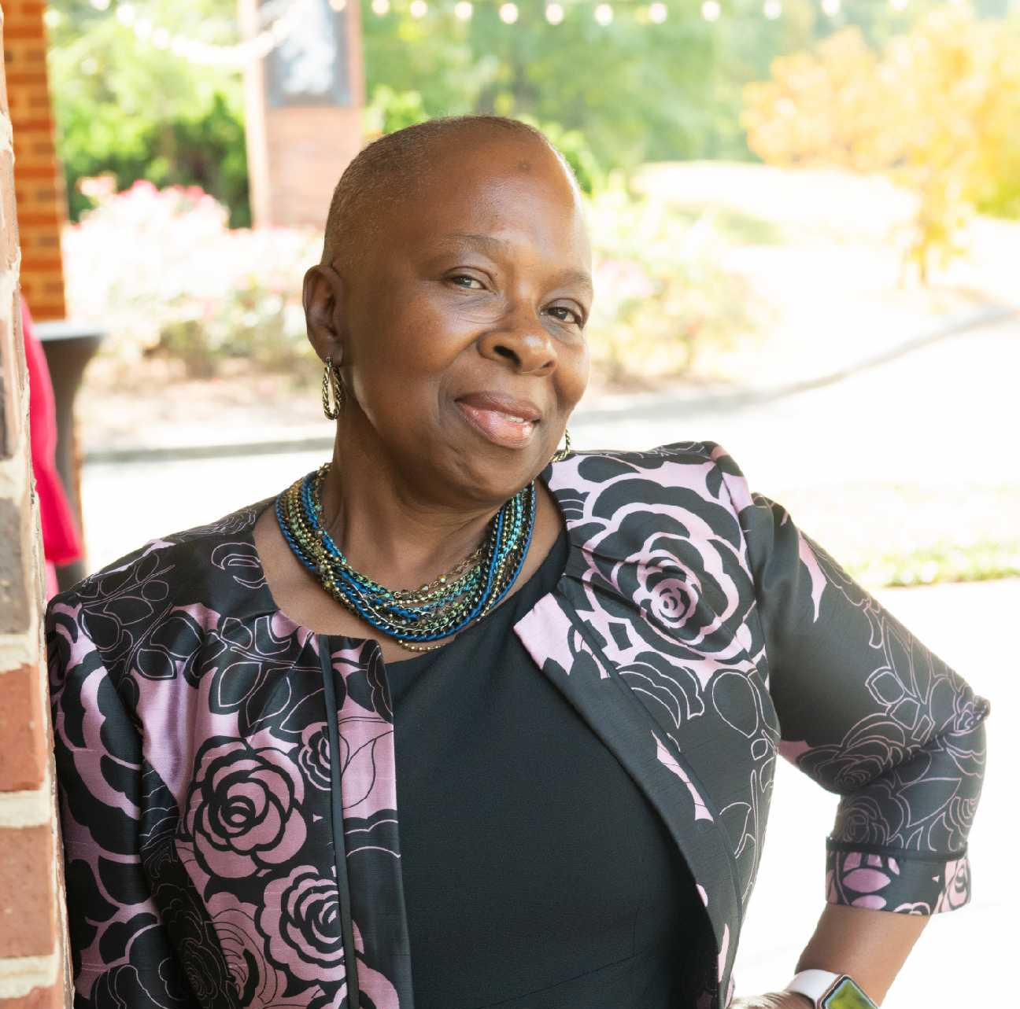
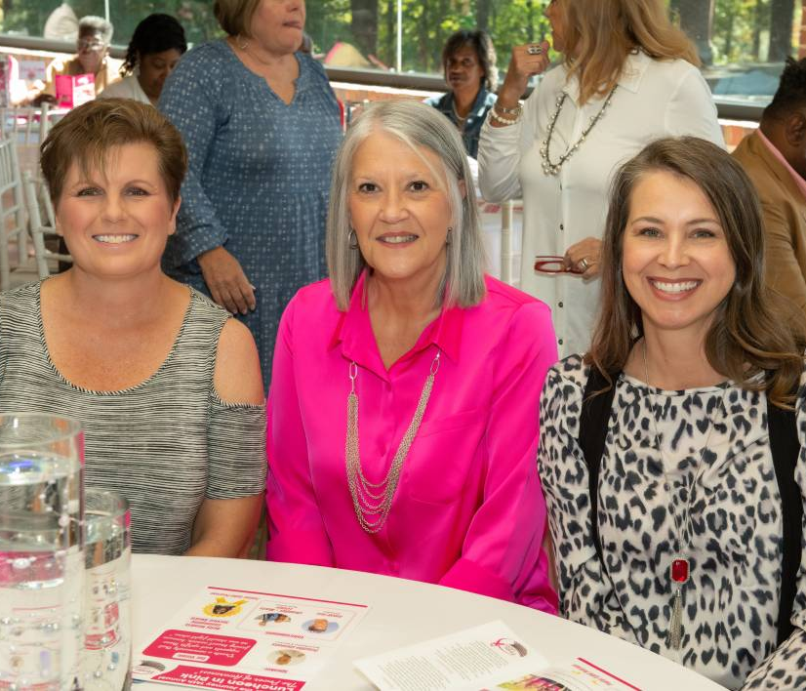
YOU’RE INVITED!
To our 16th Annual Luncheon in Pink!
Join passionate volunteers, community leaders, survivors, breast cancer patients, physicians, and neighbors in celebrating the miracle of life.
Saturday, October 5th, 2024
12:30 PM
Lion Hills Vineyard
400 Murphy Industrial Blvd. Bremen, Georgia

Slide 3

WHAT IS LUNCHEON IN PINK?
Luncheon in Pink is a celebration of life. This annual fundraising event not only supports the mission of Hope for the Journey but serves as a time for the community to stand together and reflect on life. We recognize and award survivors, breast cancer patients, and caregivers. We are asking you and your company to support our mission of giving hope to those facing breast cancer.
Saturday, October 5th, 2024
12:30 PM
Lion Hills Vineyard
400 Murphy Industrial Blvd.
Bremen, Georgia

Slide 4
WHO WE ARE
  Our Vision
  Our vision is to create a community that supports and uplifts those fighting breast cancer, because no one should have to fight alone.
  Our Mission
  We wish to give hope to those facing breast cancer and those walking the journey with them.
  Our Programs
  Hope for the Journey provides resources and programming to the West Georgia community through five main channels of support: financial assistance and resources, counseling, spiritual support, education (outreach and awareness), and peer support and knowledge through special programs and ongoing support groups. Our organization strives to empower those women and their loved ones as they walk the journey and continue to fight breast cancer.

Slide 5
WHAT’S NEXT?
We are gearing up to do it all again!
Expand outreach & programming to serve more women
Special Recognition of Our Community & Honored Guests
Luncheon in Pink
10/05/24

Slide 6
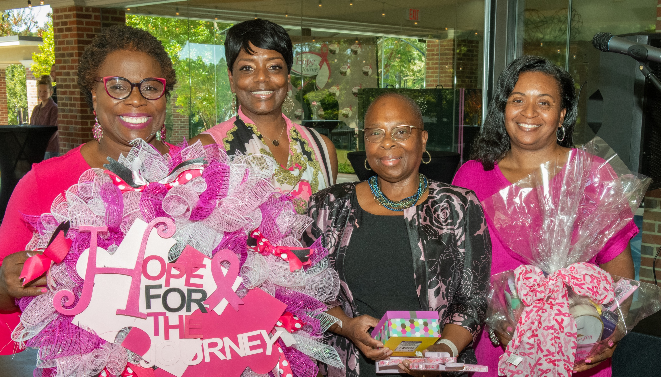
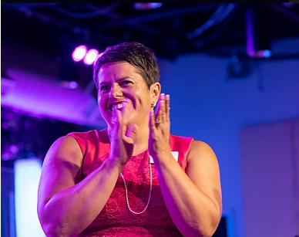
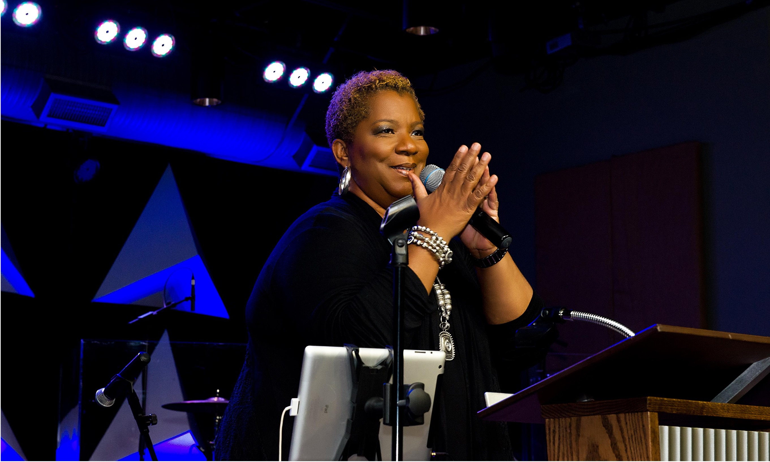
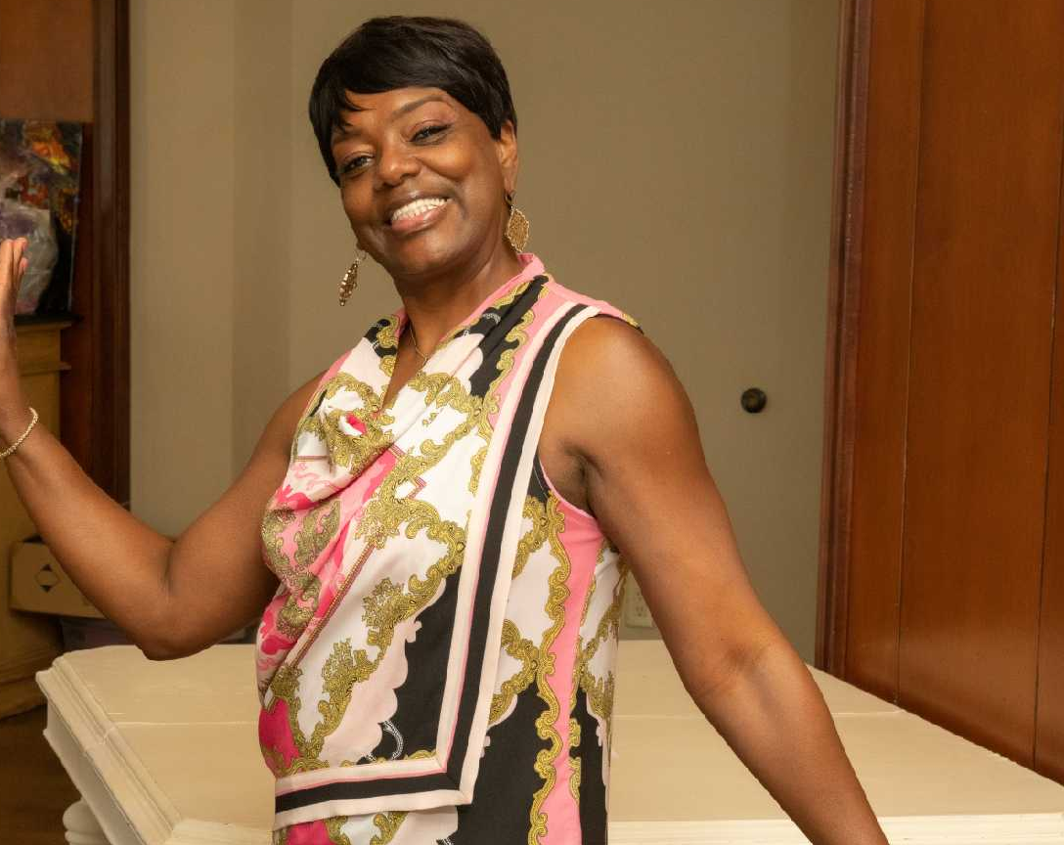
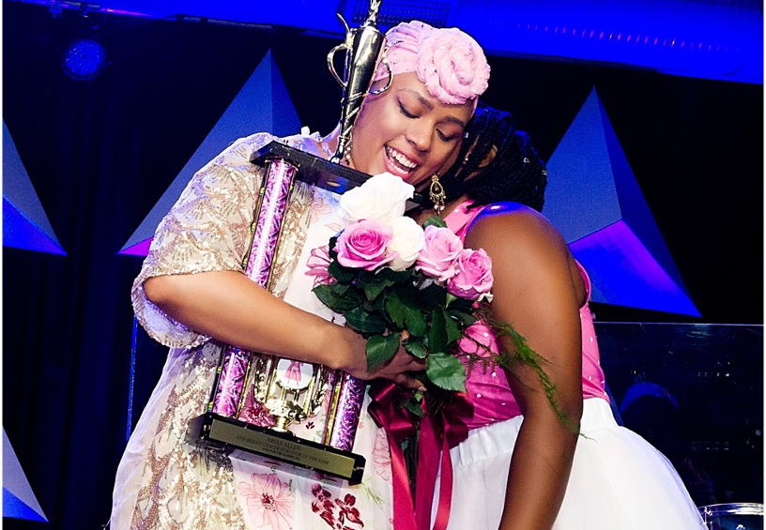
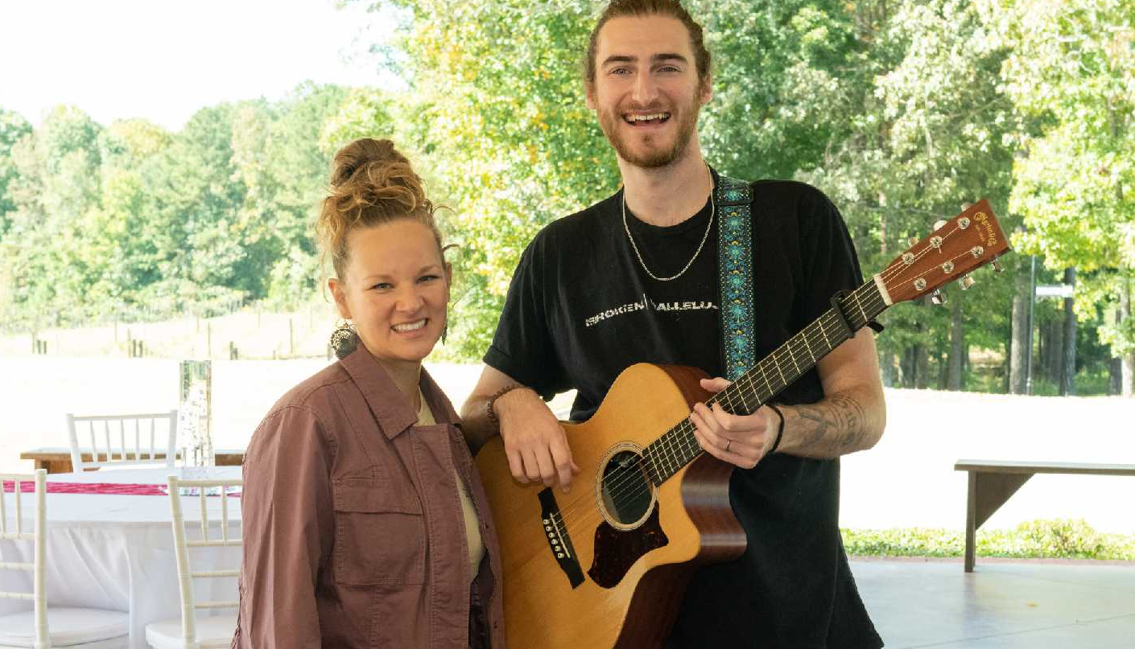

Slide 7
“Festivals promote diversity, they bring neighbors into dialogue, they increase creativity, they offer opportunities for civic pride, they improve our general psychological well-being.”
– David Binder

Slide 8
Co-host & Partner
$2,500 Sponsorship
Benefits
PRESENTING
SPONSOR
Recognition as the Presenting Sponsor and Event Co-Host for the 2024 Luncheon in Pink
Your name/logo prominently displayed during the event
Your name/logo prominently displayed on the 2023 Luncheon in Pink promotional materials
Your name/logo co-branded on all event emails
Recognition as the Presenting Sponsor on Hope for the Journey’s social media platforms and website
Full page color ad or message in the digital event program
Your name/logo to be recognized as event presenting sponsor in all media releases
Opportunity to provide a video (3-5 minutes) to be shown during luncheon
8 VIP tickets
Serving as a co-host of the luncheon, you will be recognized as an official presenter of the 2024 Luncheon in Pink.
Your name/logo will be prominently featured in all event promotions. Your partnership ensures the support of women in our community for this year and the year ahead!
Aside from being recognized as a presenting sponsor of this signature event, you’ll receive an array of sponsorship benefits.
P

Slide 9
Leave a
Mark
$1,500 Sponsorship
Benefits
INSPIRING
SPONSOR
Your name/logo prominently displayed virtually
Your name/logo prominently displayed on the luncheon flyers
Half page color ad or message in our event program book
Recognition as a sponsor on Hope for the Journey’s social media platforms
Your name/logo to be recognized as an event sponsor in all media releases
Recognition as a sponsor on Hope for the Journey’s website
Opportunity to provide a video (3-5 minutes) to be shown during luncheon
6 VIP tickets
This event has quickly become one of the community’s signature experiences.
Your partnership will cover any additional costs incurred from the event in addition to supporting new programming in 2024.
Aside from recognition as a partner, your sponsorship at this level will receive these great benefits.
I

Slide 10
Cause a Connection
$750 Sponsorship
Benefits
COURAGE
SPONSOR
Your name/logo recognized as a sponsor and partner for the event giveaway
Your name/logo prominently displayed on the luncheon flyers
Quarter page color ad in the digital event program book
Recognition as a sponsor on Hope for the Journey’s social media platforms
Your name/logo to be recognized as an event sponsor in all media releases
Recognition as a sponsor on Hope for the Journey’s website
4 VIP tickets
You or your organization’s donation will be supporting event giveaways for our attendees to enjoy. Most importantly, your partnership will support our ongoing programming, ultimately ensuring the Hope for the Journey’s success.
Aside from recognition as a partner, your sponsorship at this level will receive the following benefits.
C

Slide 11
Make an Impact
$500 Sponsorship
Benefits
HOPE
SPONSOR
Your name/logo prominently displayed on the luncheon flyers
Your name/logo in the digital event program book
Recognition as a sponsor on Hope for the Journey’s social media platforms
Recognition as a sponsor on Hope for the Journey’s website
2 VIP ticket with
Your sponsorship ensures Luncheon in Pink’s success. Your support at this level will go towards the luncheon and fulfilling our mission.
As a partner in this journey and in support of the event, your sponsorship at this level will receive the following benefits.
H

Slide 12

LET’S PARTNER TOGETHER!
To learn more about the event or donate online, please visit:
www.hopeforthejourneywestga.org
To become a sponsor and pay by check, please send checks to:
Hope for the Journey
P.O. Box 1344 Carrollton, Georgia 30112
Have questions? Contact Us.
Rosie Holley, Executive Director
hope4thejourney1@gmail.com or execdirector@hopeforthejourneywestga.org
770.214.1491
Follow Us.
@HopefortheJourneyCarrollton @HopefortheJourneyWestGA
501(c)(3)

